Slide 1
COLUMBUS ORCHID SOCIETY, MEMBER TALK
Paphiopedilum Culture
Jean Dean, VP. October 17, 2026, Franklin County Library. About 35 minutes plus Q and A.

Slide 2
1. Know your group
Mottled-leaf species
Such as sukhakulii and callosum: warmer, lower light, shade-house conditions.
Strap-leaf multifloral
Rothschildianum and sanderianum: brighter, longer to maturity, worth the wait.
Complex hybrids
Forgiving and showy, a good entry point for new growers.

Slide 3
2. Water and media
• No moisture stress; Paphs have no pseudobulbs to fall back on.
• Fine to medium bark with perlite and charcoal; repot every 12 to 18 months as media breaks down.
• Rainwater or distilled; they resent salt build-up. Flush monthly.

Slide 4
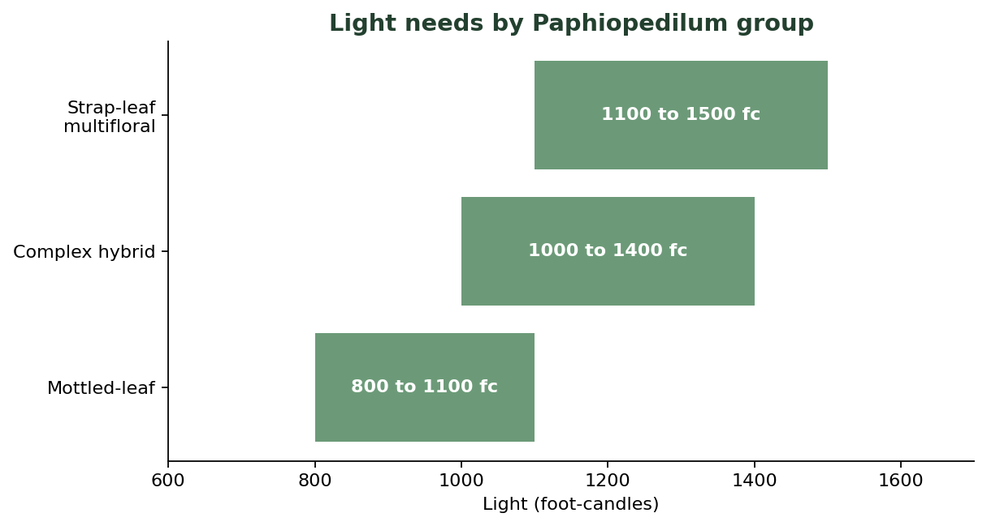
3. Light and temperature
• 1000 to 1500 foot-candles; east bench in my greenhouse.
• Cool nights of 55 to 60F help spike initiation in many species.
• Match light to leaf type: mottled lower, strap-leaf brighter.
Light band by group, measured at the bench

Slide 5
4. Feeding
• Weakly, weekly: quarter-strength balanced feed during active growth.
• Back off in deep winter when growth slows.
• Flush monthly to keep salts from building in the media.

Slide 6
5. Showing
• Stake early and gently; the dorsal sepal should sit flat and symmetric.
• Groom the foliage; judges read the whole plant, not just the flower.
• Photograph each entry for your own records before load-in.

Slide 7
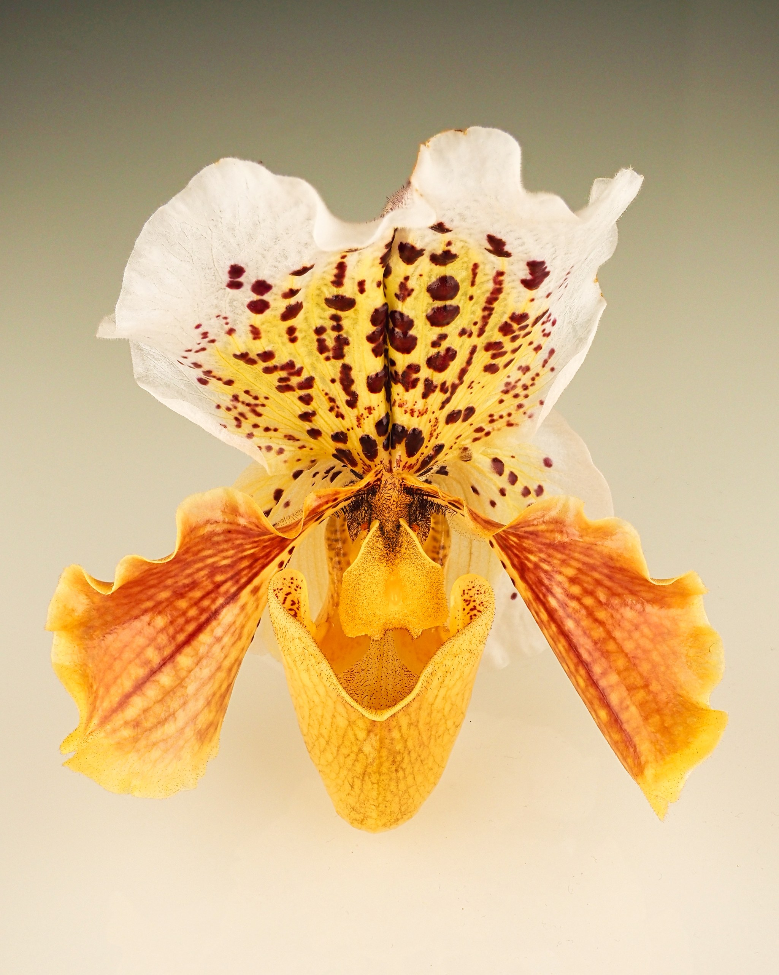
A show-ready Paphiopedilum
Flat, symmetric dorsal and clean pouch, the look judges reward

Slide 8
Closing
• Bring a plant to the next meeting table for a hands-on repotting demo.
• Questions welcome; culture sheets are on the member wiki.

